Slide 1

SAP Analytics cloud training
Anurag Bajaj
Day 1

Slide 2

INTRODUCTION

Slide 3
Agenda – Day 1
Introduction to SAP Terminologies and Analytics Cloud
- Difference between Cloud and OP systems
- Cloud Offerings
- Introduction to SAP Cloud Platform
- Difference between HANA and S/4HANA
- How ERP and BW are used today
- What are all other SAP Solutions used in industry
- What is SAP Analytics Cloud
- History of SAC
- SAC Strategy
---Break---
System Walk Through
- SAC Architecture
- Compare SAC with others
- Embedded Content
- References
- Guidance on SAC Certification
- System Walk over
- Create a simple dashboard on Covid-19

Slide 4

What is On-premise and Cloud?
An on-premise software requires following
Hardware to be purchased
Networking to be setup
License to be bought by the vendor by paying lump-sum
Hire people to manage that software
Install all OS and manage network
Hire professionals to maintain system and get development done on top
Every upgrade and new patch needs to be applied
Initial investment is very high
Scalability is difficult to achieve
e.g. outlook, SAP BW, SAP BO, SAP BPC, SAP ECC, SAP Business Suite, SAP S/4HANAOP (large corp)
Cloud Solution
No upfront hardware investment, rather we can rent HW
No need to hire skill to manage the HW – NW, OS
Software upgrades are automatic hence its vendor responsibility to upgrade
Faster innovation (3 months)
Pay per user or use – subscription (multi-services)
Scalability is easier
Lower TCO, quality is service provider’s responsibility
e.g. Gmail, Netflix, S/4HANA Cloud, SAP Analytics Cloud (SaaS) - SAC
www.anubhavtrainings.com

Slide 5
What does Cloud Offers?
SaaS
SAC, Gmail
SAP, Uber, Ola, Oyo, Amazon.com
PaaS
DB,Prog,FS,Conn,Tools
GCP, SCP (SAP Cloud Platform)
IaaS
HW,OS,NW,Base
AWS, GWS, Alibaba, Azure
Digital ocean
SAP Cloud Platform Data centers
www.anubhavtrainings.com

Slide 6
What is SAP Cloud Platform?
SAP Cloud platform is a Platform as a service for companies who like to build solutions on top of the cloud. If I am a startup software co. I can design, develop, test, host and deliver an complete software on SAP Cloud platform with available tools and services.
SAP Analytics cloud solution which is individual product of SAP is already built by SAP on SAP Cloud platform.
https://help.sap.com/doc/aa1ccd10da6c4337aa737df2ead1855b/Cloud/en-US/3b642f68227b4b1398d2ce1a5351389a.html
SAP Cloud platform user infrastructure provided by AWS, GCP, Azure and Alibaba.
AWS – what used as IaaS to get the SAC service on cloud.
www.anubhavtrainings.com

Slide 7
What is HANA and S/4HANA?
HANA – Stands for High Performance Analytical Appliance
It is SAP’s in-memory DB. It keeps all data in RAM. Combination of HW and SW.
S/4HANA – Simplified, 4-th generation
S/4HANA is SAP’s new ERP system powered by SAP HANA

Slide 8
How different Solutions work?
NYC
Santa Clara
NYC
Santa Clara
NYC
ERP Data
Santa Clara
NYC
Santa Clara
ERP Data
Kings County
ERP Data
Florida
ERP Data
Kings County
Florida
NYC
Santa Clara
Kings County
Florida
Kings County
Florida
ERP Data
NYC
Santa Clara
Kings County
Florida
ERP Data
Kings County
Florida
Tableu
PowerBI
Business Data Warehouse
BOBJ
SAC
www.anubhavtrainings.com

Slide 9
What is SAP BW, BOBJ & BPC?
BW – Business Warehouse system which bring all data together using ETL from different Data sources
BOBJ – Data mining and Business Intelligence solution offers BI capabilities
BPC – Business Planning and Consolidation system for Financial, HR, etc. planning scenarios
All are on-premise solutions
SAC – SAP Analytics Cloud – All-in-One – Cloud Based
BI | Predictive | Planning | Application Design | more..
Both Co-exist and depends on Use cases, what does a co. want.
SAP – 65% world GDP, 300mn active customer, 80k partners
75% beer, 65k jet, 70% oil, 62% chocs, 350Bn per day
www.anubhavtrainings.com

Slide 10
What is SAP Analytics Cloud?
Is a Software-as-a-Service (SaaS) is an independent SAP product. It allows Business Users / CIOs/ Decision Makers to take informed and confident decision.
Decision Making = Based on past Data - BI
Confident Decision = Insight (experiences) – Turn into action – ML
SAC enables the intelligent enterprise by providing everyone with insight to make confident decisions and actions immediately. A solution which is
Complete – It’s a single solution for BI, Planning, Prediction and App design
Contextual – Turn our insight to actions in context of data
Confident – usage powerful AL-driven insights w/o any ML knowledge.
www.anubhavtrainings.com

Slide 11
History of SAP SAC?
www.anubhavtrainings.com

Slide 12
SAC Strategy - Principles of Convergence
We are converging USE CASES not FEATURES and FUNCTIONS
No Force Migration
Exception:
SAP BOBJ explorer, SAP BOBJ Dashboard – Dec 2020 – ADOBE Flash technology
SAP BOBJ Desktop Intelligence – Dec 2018
www.anubhavtrainings.com

Slide 13
Impact on Existing Solution – BI Strategy
SAP BOBJ explorer
Rombi
Lumira Desktop and Discovery
BOBJ Analysis for OLAP
Dashboard and App Design
BOBJ Designer Studio
Bex WebApp Designer
BOBJ Dashboard
Office Integration
Live Office
EPM Add-in
Bex Analyzer
Reporting
Desktop Intelligence
BOBJ Set Analytics
SAP SAC
SAP Lumira 2.x – by 2024
After must move to SAC
Analysis for Office
SAP Crystal Reports (BOBJ)
SAP SAC
www.anubhavtrainings.com

Slide 14
Impact on Existing Solution – Planning Strategy
On-premise
SAP S/4HANA for standalone planning along FIN
BPC – On-premise planning
Cloud
SAC – Stand along planning
Planning
Business Planning & Consolidation system (BPC)
Consolidation
Business Planning & Consolidation system (BPC)
On-premise
SAP S/4HANA group reporting functionality
BPC – On-premise planning
www.anubhavtrainings.com

Slide 15
Impact on Existing Solution – Prediction
SAP Data Intelligence is a solution which On-premise and allows us to create models and apply them on dataset to get prediction. Going forward all the developments related to this since 2018 were channelized to SAC.
Together with all of it, SAP introduced a state of art app builder called Application Layer.
www.anubhavtrainings.com

Slide 16
Why SAC is important as compare to outside market
Bi – Business Intelligence – Tableau (Salesforce 15.7Bn), Power BI, QuickTech
Planning – Hyperion, Apaplan
Predictive – Watson, SAS
Application Designer – UI5 & Fiori, Android, Angular, React etc.
SAC – Can cover all above scenarios.
www.anubhavtrainings.com

Slide 17
How SAC is advanced from its Competitor
CAPABILITIES | SAP – SAP ANALYTICS CLOUD | ORACLE (OAC) | MICROSOFT (Power BI) | THOUGHTSPOT* needs updating | WORKDAY (Adaptive Insights + Prism Analytics) | ANAPLAN | SALESFORCE + TABLEAU
All analytics on one cloud native platform: BI, planning, augmented​ analytics |  |  |  |  | Not in one platform |  | (no planning)
Live connection to on-premise data sources without moving the data to cloud​
Pre-built industry and line-of-business content, built by the vendor and its partners​
Hybrid analytics: offering on premise and cloud that work together​ |  |  |  |  |  |  | (Acquired through Tableau)
Embedded machine learning in business applications with process and workflow with semantics and business logic​
Board and C-suite analytics with large touch screens display UX with SAP Digital Boardroom​
End-to-end data management and analytics capabilities that work seamlessly together ​
Planning and analysis embedded with ERP​
Has this capability | Has some of this capability | Does not have this capability
www.anubhavtrainings.com

Slide 18


SAP SAC Architecture
Applications
SAP Digital Boardroom SAP Analytics Hub Mobile Experience
SAP App Center
BI
Discovery
Charts and tables
Geospatial
Planning
Events and workflows
Allocation
Value driver tree simulation
Predictive
Smart Assist
Build & deploy predictive models
Application Design
Scripting
Composites
UI theme & stylesheet
Embedding
Analytics into applications
Analytic Capabilities
Core Capabilities
Data connectivity
Wrangling
Modeling
Administration Auditing
Visualizations
Collaboration
Mobile
APIs
PaaS
SAP Cloud Platform
Amazon Web Services
SAP Data Center
Cloud data sources
and applications
On-premise data sources and applications
www.anubhavtrainings.com

Slide 19
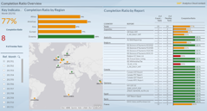
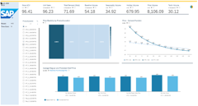
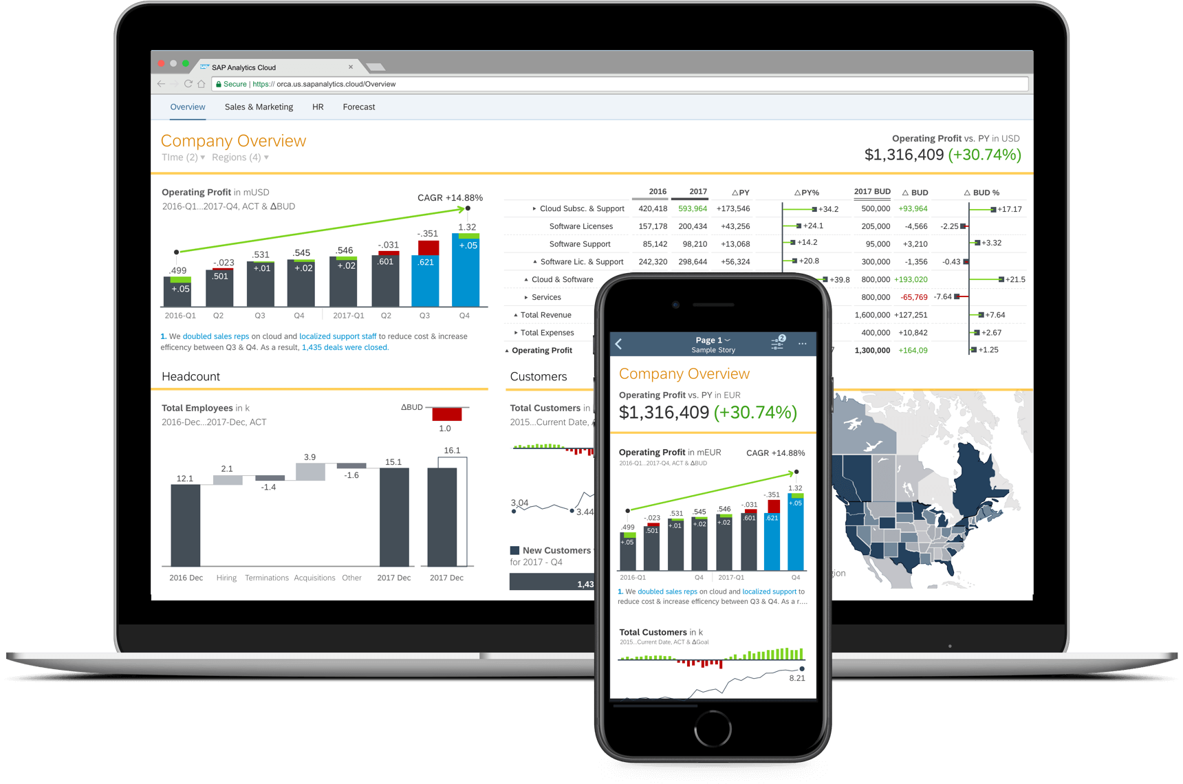

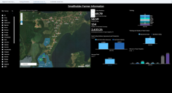
Embedded Standard Content
72 Packages by SAP
65 Packages by Partners
SAP S/4HANA
SAP C/4HANA
SAP SFSF
SAP Concur
SAP Ariba
etc..
SAP data sources
Non-SAP data sources
Accelerate your Enterprise Analytics projects with pre-built analytics from SAP and our Partners
www.anubhavtrainings.com

Slide 20
Business content delivered by SAP
SAP S/4HANA for Financial Products Subledger – Reporting
Sales Cloud for SAP S/4HANA (BPE)
Sales Performance and Target Planning (CRM)
Sales Cloud for SAP S/4HANA Cloud (BPE)
SAP Sales Planning for SAP S/4HANA Cloud
Service Cloud Analytics (CRM)
Solution Manager: Test Suite Analysis
Solution Manager IT Service Management Analytics
Sports One Analytics
Sports One Analytics (German)
Trade Management
Travel & Expense – Concur
Treasury Management
Vendor Management System (Fieldglass)
Workforce Planning for S/4HC (BPE)
Industry
Agriculture Origination, Trading and Risk Management (New)
Banking
Chemicals
Consumer Products
Customer Profitability Analysis
Engineering, Construction, & Operations
Health Care
High Tech (New)
Industry Innovation Kit – Leonardo Zero Waste
Insurance
Mill Products
Mining
Oil & Gas
Professional Services S/4HC (BPE)
Public Sector
Public Services: Higher Education and Research
Line of Business
Advanced Compliance Reporting
Business ByDesign (Finance and Procurement)
Environment, Health and Safety
Field Service Management
Finance
Finance Account Receivable – Invoice Payment Forecasting.
Finance Contract Accounts (FI-CA)
Finance – Live based on Semantic Tags
Financial Consolidation for SAP S/4HC Cloud (BPE)
Financial Planning & Analysis for SAP S/4HANA Cloud
FI Operational Expense Planning
Goods and Services Tax GST Analytics
Human Resources (SuccessFactors)
Human Resources (SuccessFactors) – Simplified Chinese Localization
Human Resources (SuccessFactors) (BPE)
Human Resources Salary Planning
Intelligent Asset Management
Integrated Financial Planning for SAP S/4HANA
Liquidity Planning for SAP S/4HANA Cloud
SAP Marketing
Manufacturing S/4HC (BPE)
Procurement
Procurement for SAP S/4HC (BPE)
Product Cost Planning
Project and Portfolio Management
Project Budgeting & Planning S/4HC (BPE)
Project Staff Planning
Receivables Management for S/4HANA Cloud (BPE)
SAP Finance – Contract-based revenue recognition (CBRR)
SAP Financial Products Subledger IFRS17 for S/4HANA (New)
SAP Integrated Business Planning
SAP Intelligent Asset Management
SAP Qualtrics - Customer Satisfaction Score
SAP Qualtrics - Survey distribution and Analysis
SAP Supply Base Optimization
Real Estate
Retail (Model Company Fashion for Vertical Business)
Retail (Model Company Core Retail)
Retail (Omnichannel Article Availability and Sourcing)
Rural Sourcing Management
Utilities
Packages that include Planning
Banking
Chemicals
Finance
Financial Planning & Analysis S/4HC (BPE)
FI Operational Expense Planning
High Tech
Human Resources Salary Planning
Integrated Financial Planning for SAP S/4HANA
Liquidity Planning for SAP S/4HANA Cloud (BPE)
Oil & Gas
Product Cost Planning
Project Budgeting & Planning S/4HC (BPE)
Project Staff Planning
Sales Performance and Target Planning (CRM)
Sales Planning for SAP S/4HANA Cloud (BPE)
Travel & Expense (Budget Planning)
Workforce Planning for SAP S/4HC (BPE)
Further information can be found in the following blog
www.anubhavtrainings.com

Slide 21
References
SAP Analytics Cloud Product Roadmap
SAP Analytics Cloud Help Documentation
SAC Webinars
Help Library
Free learning videos
What’s new with SAP SAC
SAC YouTube Playlist
SAC Admin guide for Live connection
https://www.sapanalytics.cloud/plans/
Register for your SAP SAC Server
https://blogs.sap.com/2019/06/24/webinar-summary-sap-bi-roadmap-update-with-saps-patrick-sims/
www.anubhavtrainings.com

Slide 22
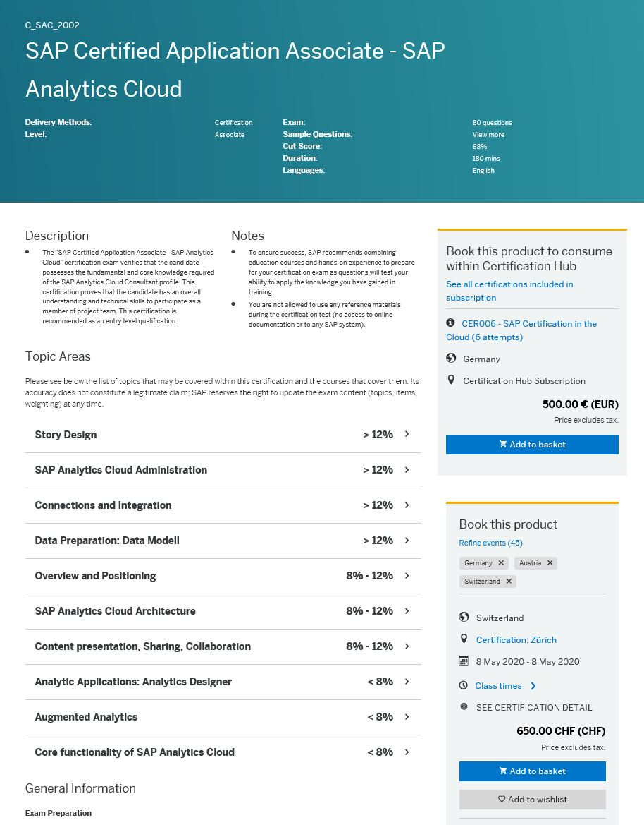



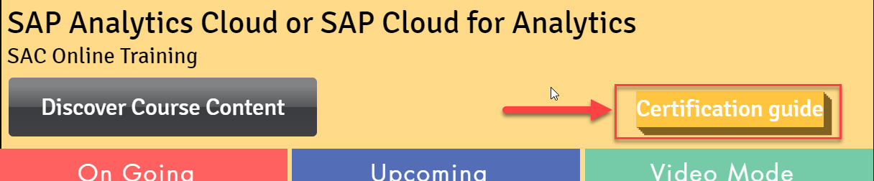
SAP Analytics Cloud Certification – C_SAC_2021
One SAP Analytics Cloud Certification (SAP Certified Application Associate - SAP Analytics Cloud) was rolled out in December 2019.
This certification proves that the candidate has an overall understanding and technical skills to participate as a member of project team.
Certification Hub Subscription : 500 € (EUR)
CER006 - SAP Certification in the Cloud (6 attempts)
https://www.anubhavtrainings.com/analytics-cloud-training
www.anubhavtrainings.com

Slide 23
System Walkthrough

Slide 24
Example Use case
You are working as Sr. Healthcare officer at WHO. Your job is to understand the on-going pandemic and its infection spread across countries. We want to understand the country wise cases and spread curve on timeline.
Dataset is available here

Slide 25
End of Day 1

Slide 26

Questions

Slide 27

Anurag Bajaj
anurag.bajaj02@gmail.com

